Slide 1
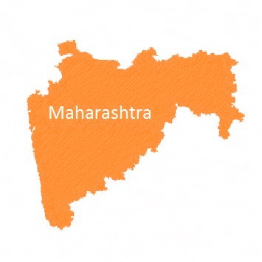





Maha Event Maha Walkathon Maha Impact Maha Scale Maha Opportunity Maharashtra
A Unique Opportunity to showcase your brand across the state
www.mahawalkathon.com

Slide 2

The Problem
Noise Pollution
Vehicular honking has reached 70% of noise pollution in our environment. Normal acceptable ambient sound levels for humans is 55 decibels, most of Mumbai registers over 70 decibels, much above safe levels for human habitation levels. Most vehicle horns create 110 db of noise.
Road Safety
There are more than 1.5 lac deaths by road accidents in India annually and Maharashtra accounts for 15,000
The department is concerned and keen to take measures to reduce the same.
The Consumer / Vehicle Owners
Are educated
Are aware of the perils
But still adamant to follow norms.
Inspite of strict laws
The real issue is consumer behavior as well as awareness
www.mahawalkathon.com

Slide 3

Searching for a Solution
A change in consumer behavior / mindset
does not occur overnight,
hence an event like a marathon which is a single day event and only gets one person from a family does not serve our cause.
To ensure a change in consumer behavior, we need
To Educate the masses
Create awareness
Remind them on a longer time frame and not one day
Involve the Family
Get them to buy the idea and not just try to sell them the idea
www.mahawalkathon.com

Slide 4


The Solution Maha Walkathon
Maha Walkathon – Annual event designed to
Educating the masses
Especially vehicle owners
Through their own family
An event which is
A high impact event
Across the state and not restricted to a city
A 200 day event to ensure message is retained
Family event ensuring inclusivity
An idea where children sell the idea to parents
www.mahawalkathon.com

Slide 5




The Causes
# No Honking
# Road Safety
# Responsible Driving
www.mahawalkathon.com

Slide 6
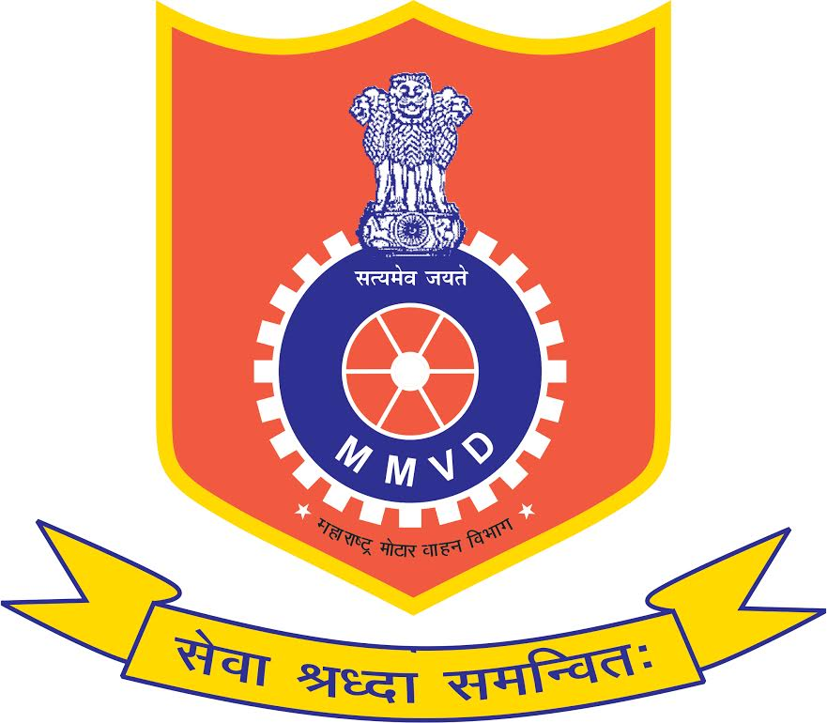

The Event ‘Maha Walkathon’
Jointly Presented by
Motor Vehicles Department, Government of Maharashtra, https://transport.maharashtra.gov.in/1035/Home
CASI Global, the largest peer to peer group for CSR & Sustainability
CSR Diary, The Volunteering Platform www.csrdiary.com
www.mahawalkathon.com

Slide 7

Two Parts to the Maha Event
Part 1
A Walkathon at over 100 places same day same time
On 18th November 2018
2 KM walk
Part 2
A drawing & Essay competition for all student participants
At their convenience within these 200 days
Display of these drawings at local traffic signals
www.mahawalkathon.com

Slide 8

Invitees to the Event
Invitees to the Drawing & Essay Competition
Every Education Institute across the state
Invitees to the Maha Walkathon
Schools
Colleges
Corporates
Individuals
www.mahawalkathon.com

Slide 9

The Plan to Reach the Masses
The Reach
Schools / Colleges across the state will be invited to participate in
1) Drawing & Essay Competition
2) Walkathon
Citizens across the state will be invited though extensive use of social media
The Commitment
MMVD, Traffic Department, Government of Maharashtra, CASI & CSR Diary will deliver the invites personally and also through other channels.
This shows the commitment of the department towards the cause
www.mahawalkathon.com

Slide 10
Showcase yOUr Brand
The Maha Opportunity @ Maha Walkathon
www.mahawalkathon.com

Slide 11
How does your Brand Benefit?
Over 100,000 participants expected
Family Event
Impact / Message delivered to reach over 3 crore people
Making this the biggest event
Official Support of MMVD Traffic department, Government of Maharashtra
100 Plus locations same day same time
Makes this a unique record
200 day* event
2 KM walk makes this a total of 2 lac kilometers*
5 times as much as the earths circumference of 40,075 KM
Grand Finale: Sponsors* will be invited to Grand finale where all winning drawings / essays will be displayed to the department staff (GoM)
www.mahawalkathon.com

Slide 12
Brand Benefits** continued
Association with Maha Walkathon (Motor Vehicles Department, GoM, CASI, CSR Diary)
Branding at all 100+ locations (Banners, standees, etc)
Social Media coverage (including Maha Walkathon FB page and FB / linkedin ads)
Posters at all covered Educational Institute across Maharashtra
Brand association mention on Maha Walkathon official website – www.mahawalkathon.com
Print Media – coverage in a leading newspaper
Extensive use of Social media
Brand coverage in Coffee Table Book
Brand coverage in all participant invitations
Selfie corner at all locations
Brand coverage on all participant certificate
Brand coverage on all certificates issued to participating educational institute
Opportunity to present Prizes / Medallions
Brand coverage on every Medallion
Brand coverage on every medallion strap
Brand coverage on every participant BIB
Brand coverage on every participant T Shirt
Brand Coverage on every participant Cap
Brand Coverage on every Goodie bag
Refer Attachment on Sponsorship rates and benefits for comprehensive coverage
www.mahawalkathon.com

Slide 13
Maha Marketing Plan (Simple & Effective)
The noise in the market place makes it impossible for a brand to communicate its message effectively.
We believe in reaching out effectively, Keeping it simple yet efficient.
Posters @ Colleges / Schools ensures participation
Drawing competition makes it high impact
Drawing competition ensures high involvement
Family event (small distance) ensures high involvement with decision makers
100 Plus* locations ensures reach
200 day* event ensures high recall
Scale; reach of 3 crore* people ensures a wide audience.
Special recognition for institutes ensures higher participation
Coffee Table book at the end of the event
High use of social media to reach masses
www.mahawalkathon.com

Slide 14
Prologue to the Maha Walkathon
The causes of “Responsible Driving, Road Safety and No Honking” are gathering strength day by day. At the inaugural ceremony of our 29th Road Safety Week; launched by our Honorable Chief Minister Shri Devendra Fadnavis the movement has garnered further momentum (23 Apr 2018)
With this backdrop in mind, MMVD, CASI Global & CSR Diary have organized Maha Walkathon. This Walkathon will be held across 100 locations – same day; same time. This is a unique event where every education institute, society and corporates are invited to participate. The idea is to reach out to and involve every citizen of Maharashtra and further educate them on perils of noise pollution and encourage #ResponsibleDriving, #RoadSafety, #NoHonking
This is a planned annual event being held this time on 18th November 2018.
MMVD, CASI and CSR Diary are totally committed to the above causes and all our members will reach out to as many institutes & societies as possible encouraging them to participate.
All Educational Institutes and Corporates have been personally invited by Shri S. B. Sahasrabudhe (Additional Commissioner; Transport) which shows the level of commitment and faith in MahaWalkathon and the benefits that will be derived throughout Maharashtra by every citizen! (letter attached)
www.mahawalkathon.com

Slide 15
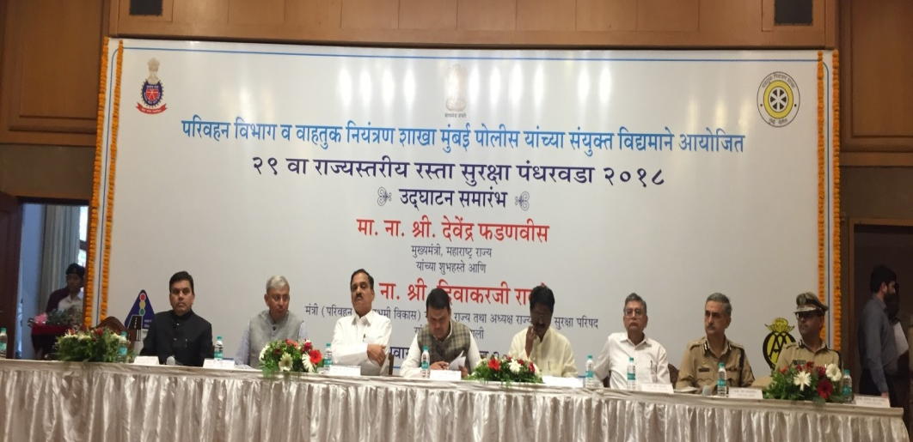
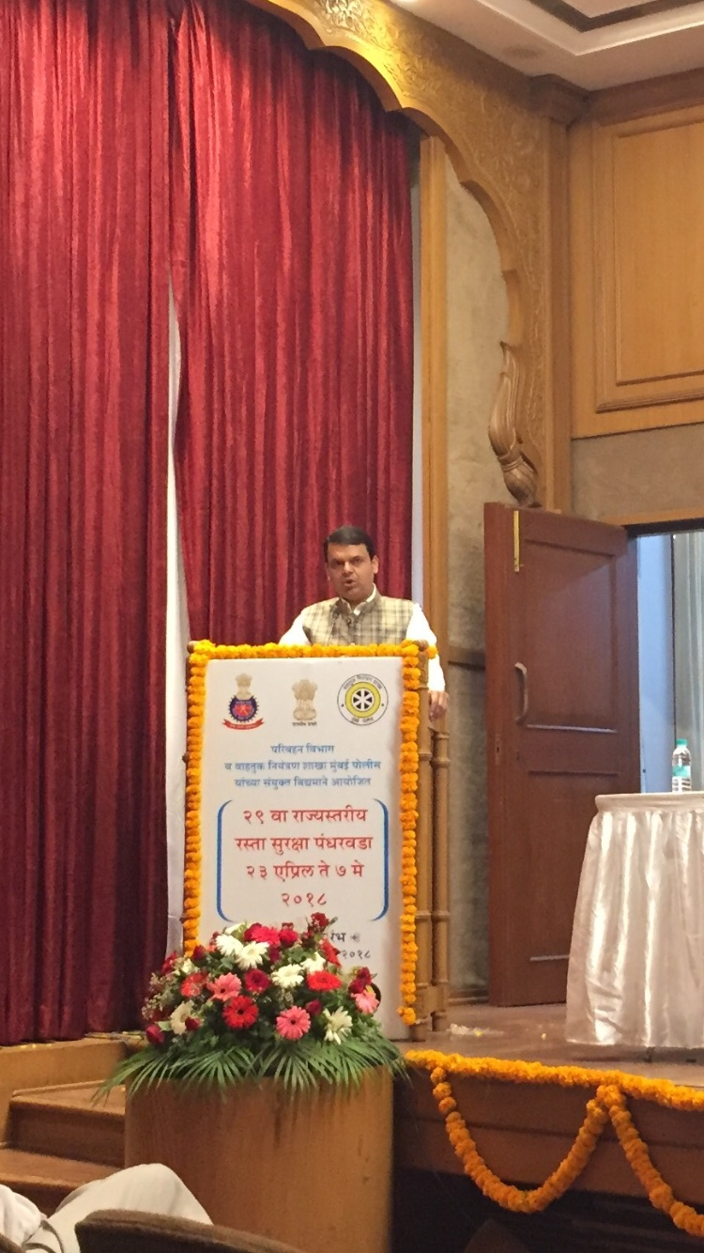
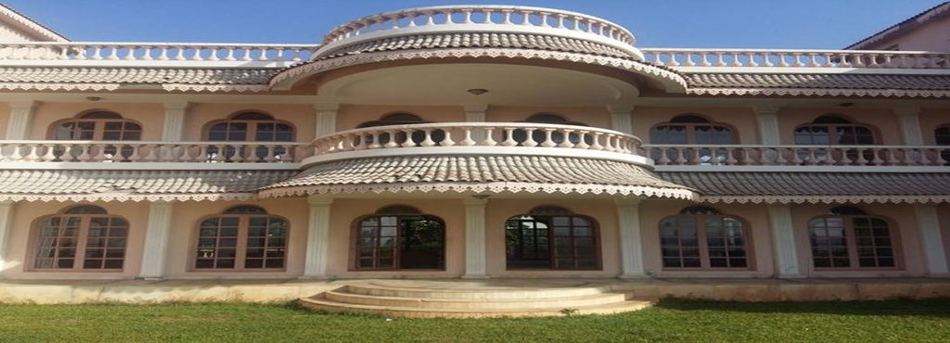
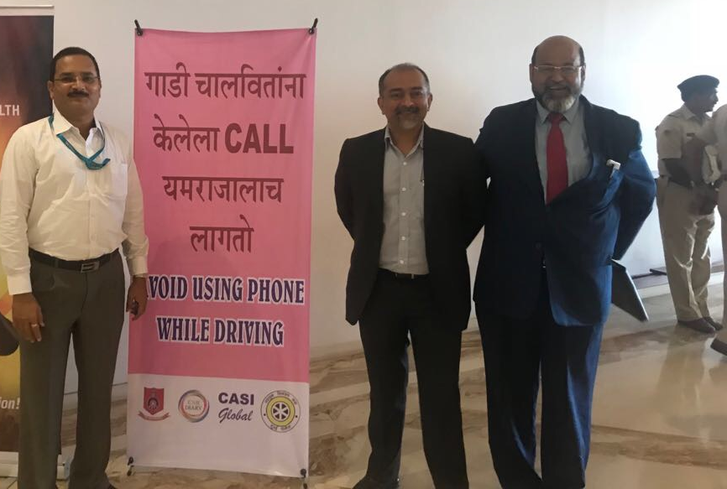
Glimpses: 29th Road Safety Fortnight – Inaugural ceremony (23 Apr 18)
Event held at Sahyadri Guest House, Malabar Hill
www.mahawalkathon.com

Slide 16

Contact:
Dr. Mitez Sheth : +91 9833570282
Prof. Paresh Sheth : +91 9820608727
www.facebook.com/mahawalkathon
www.mahawalkathon.com
Mahawalkathon@gmail.com
#MahaWalkathon
Enclosed:
List of Tentative Locations
Sponsorship Rate Card
*Refer Terms
*Conditions apply *Event subject to change without prior notice
Maha Event Maha Walkathon Maha Impact Maha Scale Maha Opportunity
www.mahawalkathon.com | mahawalkathon@gmail.com

